Slide 1

Group 4
Nathan Cunanan, Computer Engineering
Nathaniel Dunn, Electrical Engineering
Daniel Vicenti, Computer Engineering
Eric Watson, Computer/Electrical Engineering
Adam Bush, Computer Engineering
Notes:
Nathan

Slide 2
Project Motivation and Goals
Build an affordable gunshot detector for public safety, law enforcement, and military applications.
An audio-recording device that can be attached to either a building or vehicle.
A program that can be downloaded and used on a host computer, and detects and locates gunshots in audio from the device.
Notes:
Daniel: Regardless of your stance, everyone can agree that gun violence is a national issue. Project Minuteman aims to create an affordable gunshot detector designed for public-safety, law-enforcement, and military applications.

Slide 3
Project Overview
Project Minuteman is a gunshot detector utilizing an array of microphones and a companion computer program to analyze the audio.
Detection is handled through binary classification using a convolutional neural network.
Once detected, multilateration is used to find the direction of the gunshot with respect to the device.
The program will then alert the user and present the direction of the gunshot with respect to the device’s GPS location.
Notes:
Daniel: Project Minuteman is a gunshot detector utilizing an array of microphones, an artificial neural network, and multilateration for analysis, detection, and for locating the direction of the gunshot.

Slide 4
Requirements and Specifications
 | Target | Tested Within | Units
Has a maximum range of: | 250 | 160 | Meters
Locate gunshot direction within: | 5 | 1 | Degrees
Can detect a gunshot with greater than: | 95% | 99.2% | Accuracy
Identify and display gunshot within: | 2 | .4 | Seconds
Costs about: | 150 | 100 | USD
Device dimensions: | 100 x 100 x 50 | 100 x 100 x 50 | Centimeters
For audio sensors, has at least: | 5 | 5 | Microphones
Notes:
Daniel: This is a combined table of our project requirements and specifications. So far we have been able to test our network’s detection range of gunshots to within 160m. Unfortunately we did not have access to facilities that would allow us to test at 250m. Other than that we have fulfilled our requirements and specifications.

Slide 5
Prior Works
A 2013-2014 Senior Design group, Project GLASS, worked on a similar task, though they failed to meet their original goals.
Insights gained from their process include:
Attempts to do on-chip processing failed, requiring a host computer to intervene. Our design starts at this stage
Their display format was insufficient - timestamped text output. We used our results to display satellite-mapped positional data to the user
Notes:
Adam and Nathaniel

Slide 6
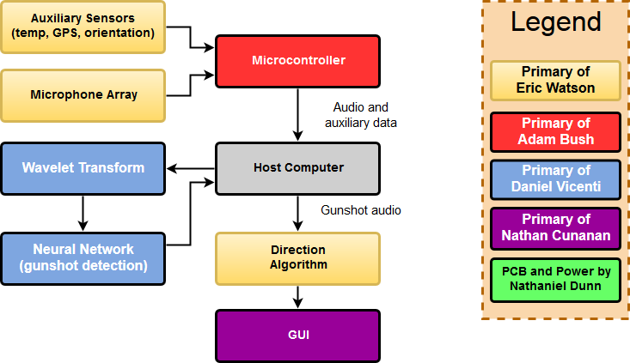
Project Block Diagram
Notes:
Adam

Slide 7
Design Choices
USB was used instead of wireless alternatives to reduce latency
Machine learning over algorithmic analysis, as the latter is less configurable and unrealistic in dynamic, uncontrolled environments
Google Maps Satellite View was chosen as the best and most accessible method for presenting easily discernible output to a user
Notes:
Adam

Slide 8
Gunshot Sound Signature Background
Mostly in the 100-10,000 Hz range
The muzzle blast is the distinctive and loudest portion of the resultant sound, and the events of interest - the early peak and the resultant drop in pressure - take place in a window of 2-3 milliseconds
The beginning of the muzzle blast, the peak of the muzzle blast, and the lowest pressure point following that peak are significant, always-present markers we will use in comparisons between the different microphones
Speed of sound = 331.3 + .606 * Temp(°C) meters/second, for a potential deviation of ~6% here in Orlando, based on the weather
Notes:
Adam

Slide 9
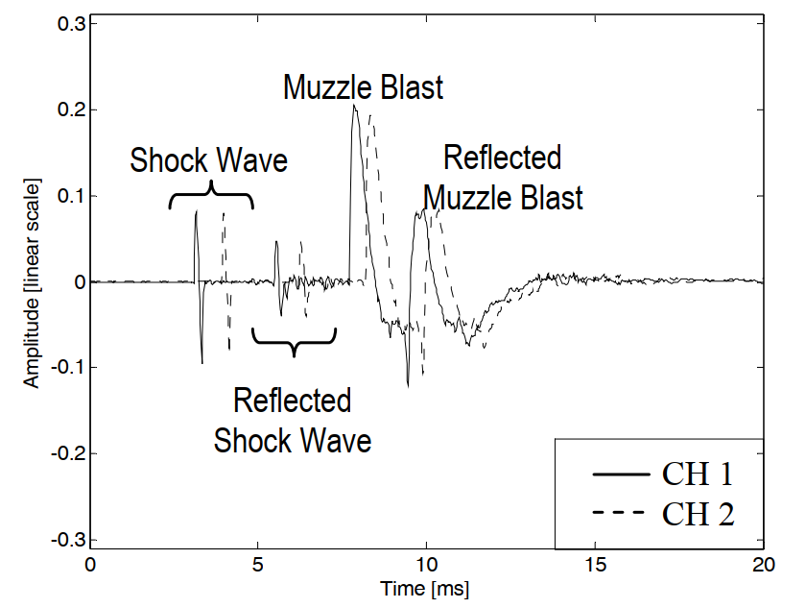
Gunshot Audio Two-Channel Example
For supersonic bullets traveling near a microphone, a shock wave may be evident in the recording
Reflected muzzle blast is shown in a very clean environment
Source: reference [2]
Notes:
Adam

Slide 10
Triangulation
Location technique that utilizes trigonometry to get the position of a sound source using angle measurements
2D triangulation utilizes two arrays with three microphones. Each array is shaped as an equilateral triangle
3D triangulation utilizes two arrays with four microphones. Each array is shaped as an equilateral pyramid
Using the angle measured and position of each array, a triangle can be formed between both arrays to get the position of the sound source
Direction of the sound wave can be considered a straight line if microphones are close together and the sound source is far away
Notes:
Eric

Slide 11
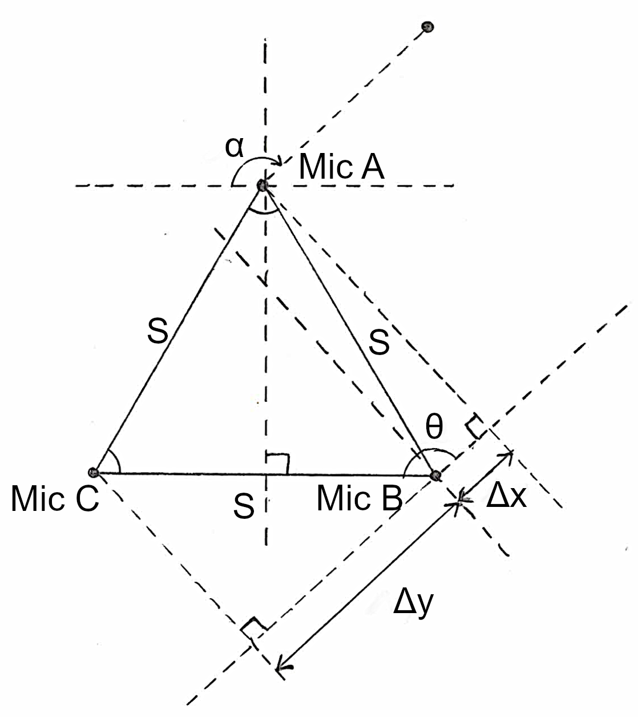
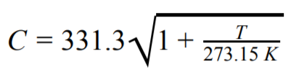

Triangulation
The distance of Δx is the time difference between the first and second microphone that picked up the sound (t_{B} - t_{A}) multiplied by the speed of sound constant (C), which is dependent on temperature, so a thermometer is required for temperature measurement.
The angle of θ can be calculated using the inverse cosine of Δx divided by the distance between the microphones (S), which is used to solve for the angle of α.
Notes:
Eric

Slide 12
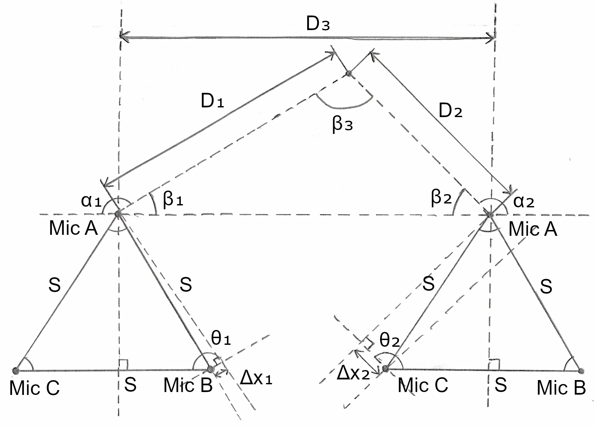
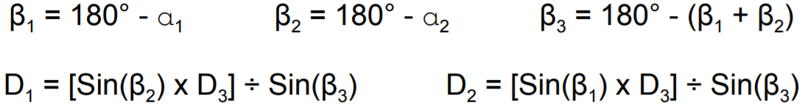
Triangulation
Each array would have a compass to provide its relative orientation and a GPS module to provide its position.
ß₁ and ß₂ are the supplementary angles of α₁ and α₂, which can be used to solve for the angle of ß₃.
D₃ is the known distance between two microphone arrays.
Knowing the values of ß and the distance between the two arrays, the law of sines can be used to solve the distance to the source from either array.
Notes:
Eric

Slide 13
Multilateration
Location technique that measures the time distance of arrival (TDOA) of an energy wave (acoustic source) with a known propagation speed (speed of sound) between two or more receivers (microphones), which forms half of a hyperbola.
2D multilateration utilizes three microphones that can be arranged in any shape and obtains the position of the sound source from the intersection of two hyperbolas.
3D multilateration works the same, but utilizes a fourth microphone and obtains the position of the sound source from the intersection of three hyperbolas.
Notes:
Eric

Slide 14
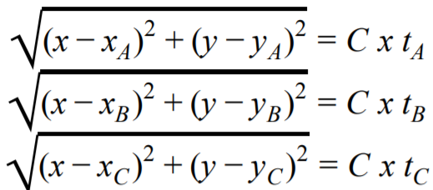
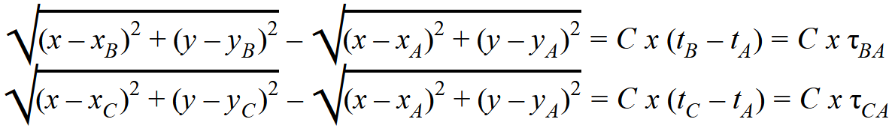
Multilateration
For 2D multilateration, the distance formula can be used for each of the three microphones in the array, which is shown on the right, where x_{i} and y_{i} are the relative location of each microphone from the origin.
The time difference between the first microphone to receive the sound and the second and third microphone can be used to form two equations that would solve two unknowns, which can then be used to get the source of the sound.
However, since the equations are not linear, solving them would be computationally expensive, so the equations would have to be linearized, but can only be done for 3D multilateration.
Notes:
Eric

Slide 15
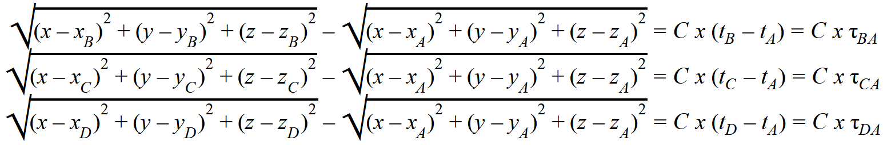
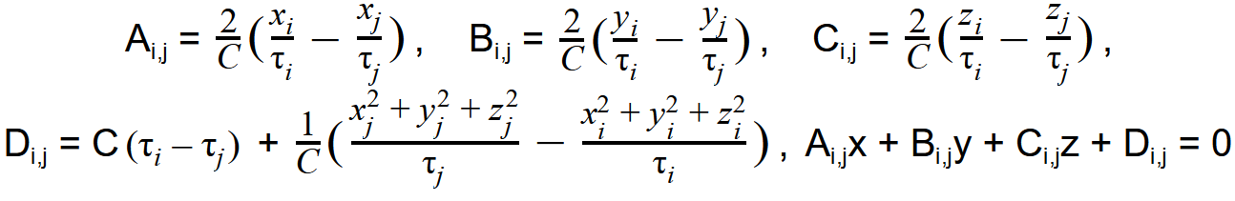
Multilateration
For 3D multilateration, four microphones or more are used, and solve for the components of x, y, and z. The difference between all microphones would then give three equations that will solve for three unknowns, as shown below.
The equation was linearized by setting the TDOA of microphone ‘i’ and the microphone ‘0’ equal to the TDOA of microphone ‘i’ and the microphone ‘j’, which was used to remove the square root. The linear form is given below:
Notes:
Eric

Slide 16
Multilateration
Utilizing the linear form, Gaussian elimination can be used, which requires a fifth microphone to solve for the values of x, y, and z.
Compared to triangulation, multilateration would only require one array to determine the position of the sound source instead of two arrays, reducing the number of components needed. This also allows the system to be mobile and also reduces the cable management needed between two microphone arrays if triangulation is used.
Notes:
Eric

Slide 17
HARDWARE
Notes:
Nathaniel, Eric, and Adam

Slide 18
Hardware Choices
Power Adapter | 12VDC Power Adapter Supply | TMEZON | $7.99
Switching Regulator | LTM4622A, LMR23610ADDA | Analog Devices, Texas Instruments | $17.31, $3.12
Power Inverter | MAX1044 | Maxim Integrated | $3.55
Microphone | CMC-6035-130T | CUI Inc. | $2.55
Global Positioning | NEO-6 u-blox 6 GPS Modules | Ublox | $25.58
Gyroscope, Accelerometer, and Geomagnetic Sensor | Bosch BNO055 | Bosch | $36.95
Amplifier | TL072 | Texas Instruments | $0.72
Microcontroller | AT91SAM3X8E | Microchip | $9.97
ADC | ADS8586SIPMR | Texas Instruments | $18.57
Notes:
Nathaniel

Slide 19
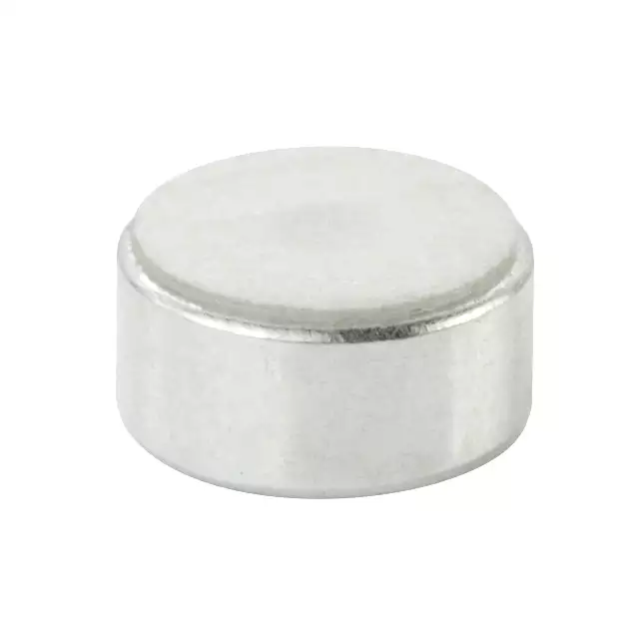
Microphone
Microphone is used to determine the position of the sound source and used to send samples to the neural network
 | CUI CMC-6035-130T | Knowles SPW0690LM4H-1
Polar Pattern | Omnidirectional | Omnidirectional
Signal to Noise Ratio | 70 dBa | 66.5 dBa
Sensitivity | -42 dB | -41 dB
Frequency Range | 100 Hz - 20 kHz | 20 Hz - 10 kHz
Maximum Input | 130 dB SPL | 135 dB SPL
Price | $2.55 | $1.65
Notes:
Eric

Slide 20
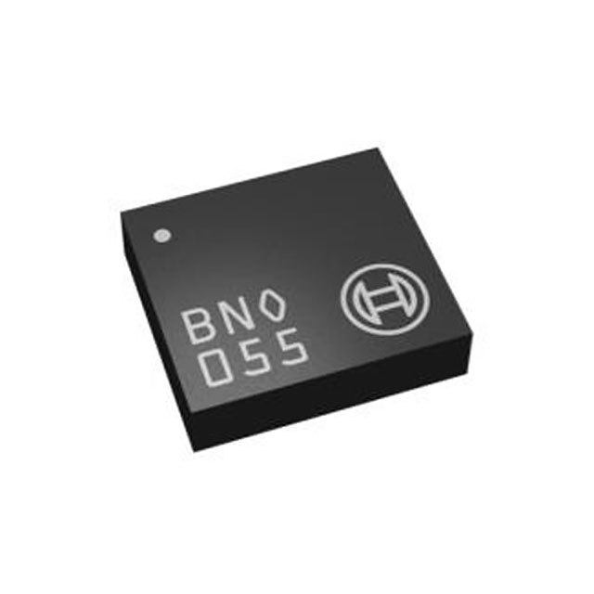
Compass Orientation Module
Used to provide the orientation of the microphone array
 | Bosch BNO055 | QST QMC5883L
Update Frequency | 400 Hz | 200 Hz
Operating Temperature | -40℃ to 85℃ | -40℃ to 85℃
Axes of Measurement | 9 - Axis | 3 - Axis
Measurement Output | Absolute Orientation | Compass Direction
Price | $30 | $15
Notes:
Eric

Slide 21
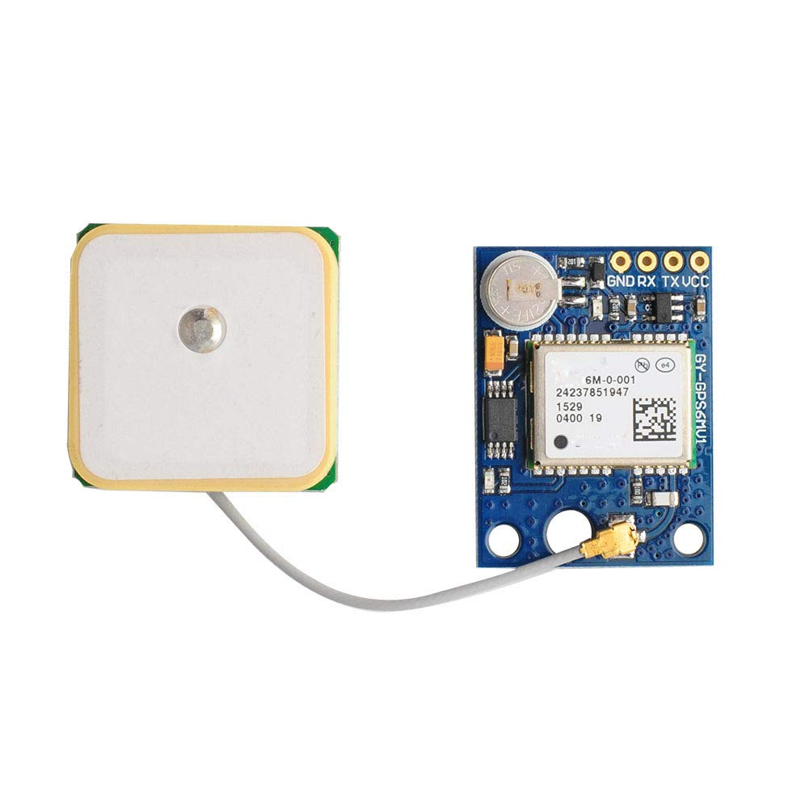
GPS Module - u-blox NEO 6M
Used to provide the position of the microphone array
Has a cold start time of 27 seconds, allowing the microphone array to be deployed quickly
Has a horizontal accuracy of 2.5 meters
Has a maximum supply voltage of 3.6V
Has a UART / I2C digital output
Notes:
Eric

Slide 22
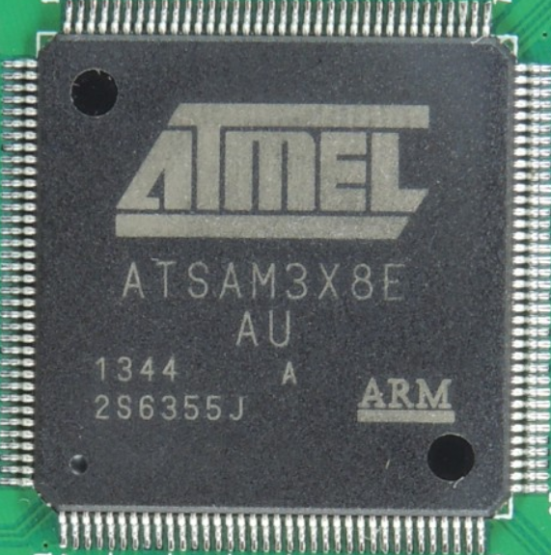
MCU - Atmel ATSAM3X8E
Low requirements: audio sampling in the 10s of KHz, USB and UART I/O
Chosen partially due to group familiarity and abundance of design resources as the MCU of the Arduino Due
$7 price tag (5,000 unit price point)
84MHz core clock, 96kB SRAM
DMA controller for all I/O:
Parallel GPIO for ADC interfacing
UART for GPS module
UART for gyroscope/accelerometer
Interrupt-driven software library for USB
Notes:
Adam and Nathaniel

Slide 23
ADC - ADS8586S
Need an analog to digital converter capable of intaking and converting multiple analog signals at once.
 | ADS8586SIPMR | ADS8588SIPMR | ADS8588HIPMR
Resolution | 16 bit | 16 bit | 16 bit
Input Type | Single Ended | Single Ended | Single Ended
Data Interface | Parallel, Serial | Parallel, Serial | Parallel, Serial
Channel | 6 | 8 | 8
Sampling Rate | 250kSPS | 200kSPS | 500kSPS
Notes:
Nathaniel

Slide 24
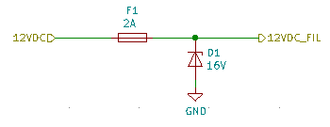
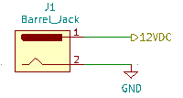
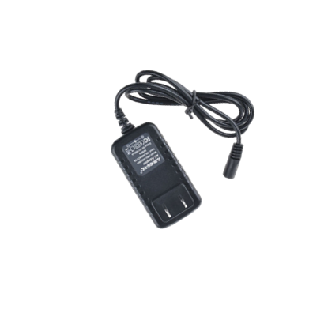
Power Supply - LMT4622A
AC wall adapter inputs 12V DC to the power supply. This regulates to two voltages, 3.3V DC and 5V DC.
Dual output voltage
High power efficiency
91% 5V DC
89% 3.3V DC
Notes:
Nathaniel

Slide 25
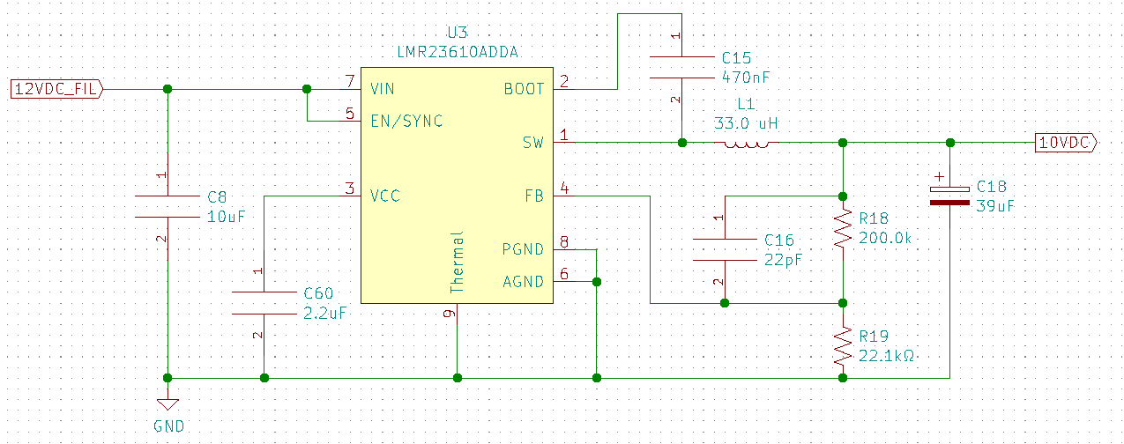
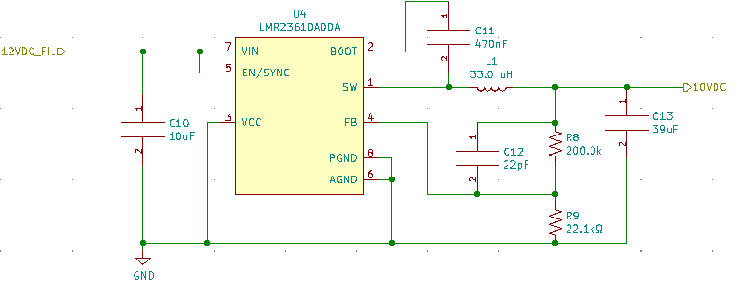
Secondary Power Supply - LMR23610
The 12VDC is regulated down to 10VDC. This is then used for the rails on the TL072.
High power efficiency 95.6%
Inexpensive

Slide 26
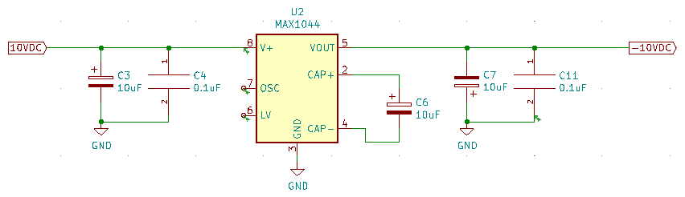
Power Inverter - MAX1044
The MAX1044 will be used to invert the 10VDC to a -10VDC for the rails on the operation amplifiers.
High output efficiency at 98.8%
Notes:
Nathaniel

Slide 27
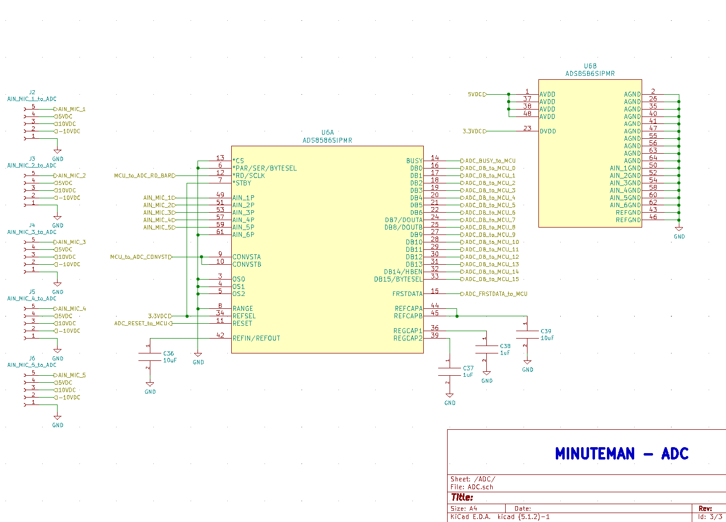
Notes:
Nathaniel

Slide 28
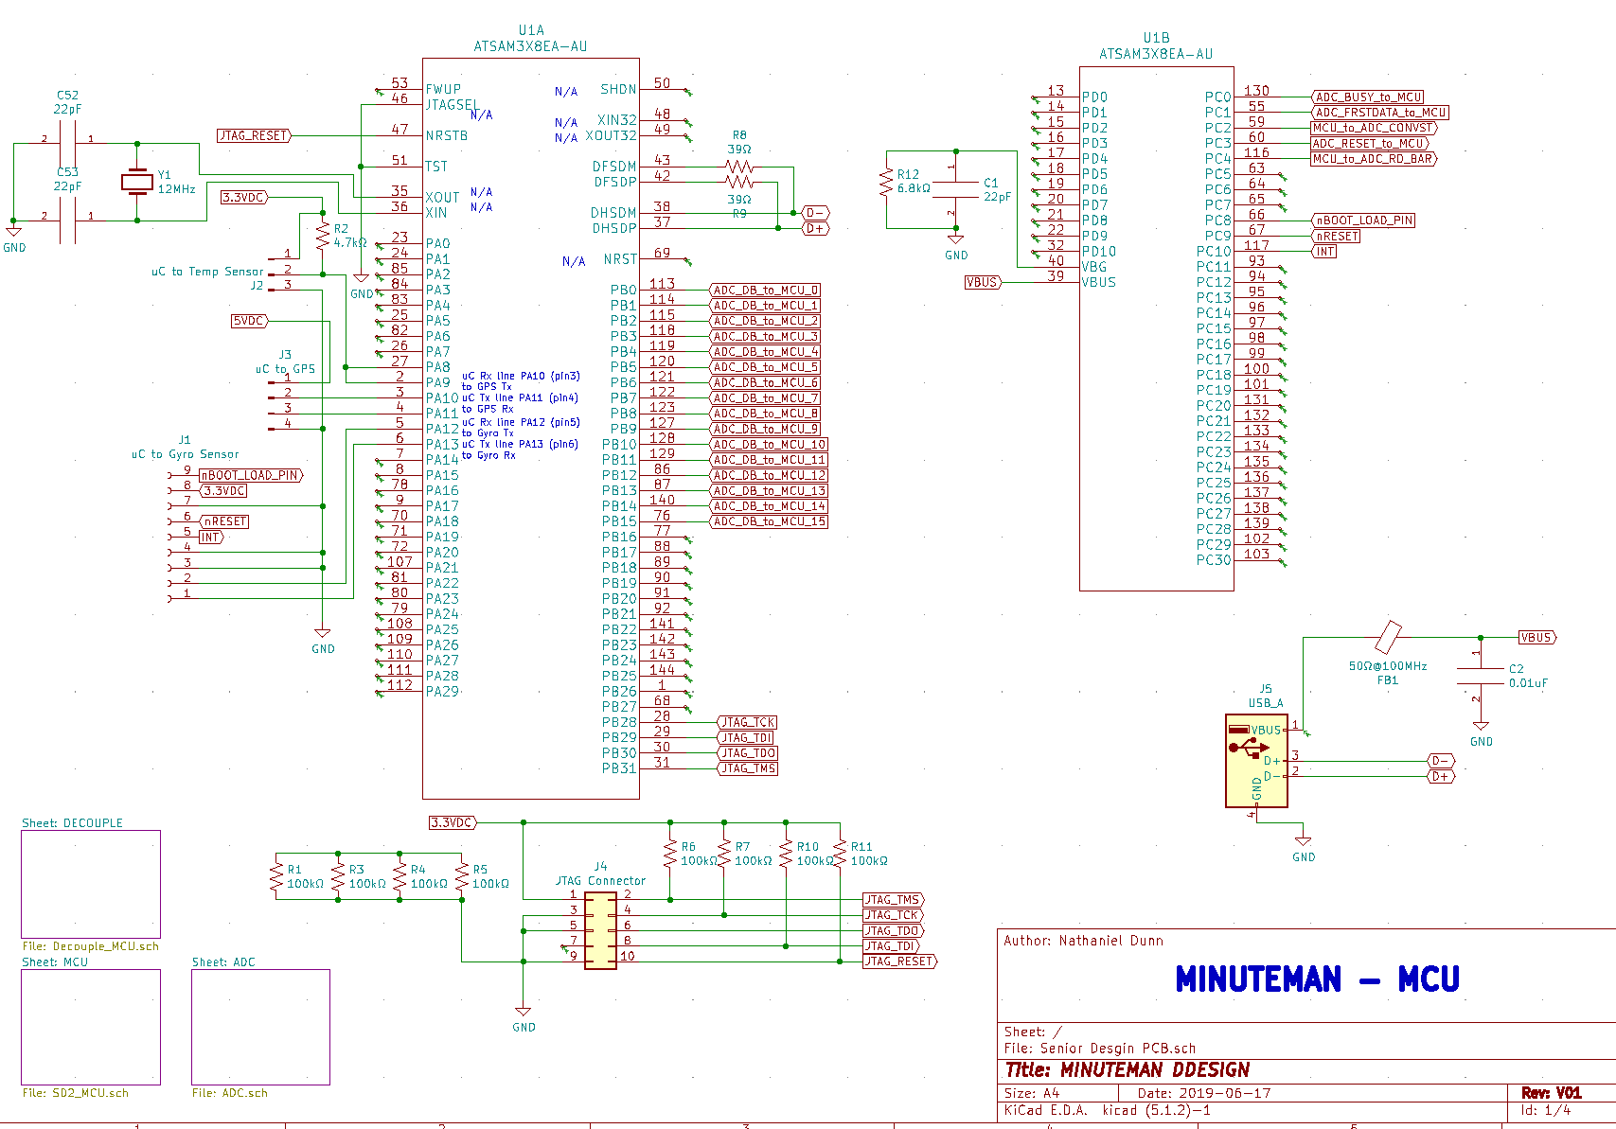
Notes:
Nathaniel

Slide 29
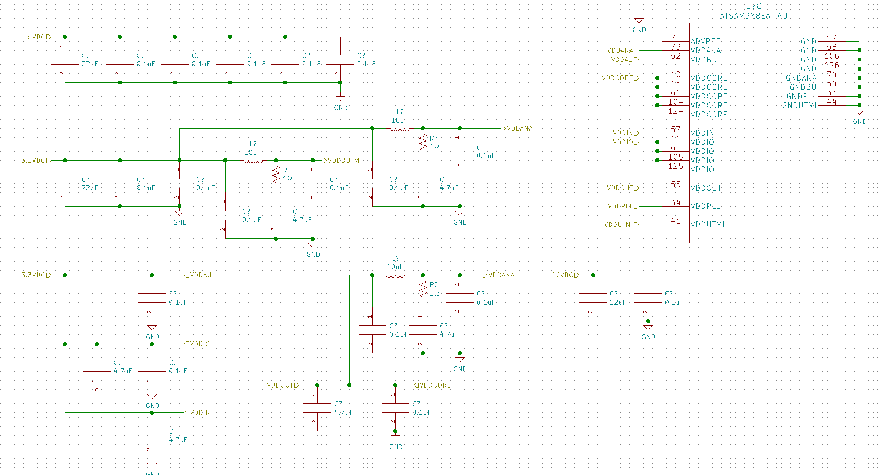
Notes:
Nathaniel

Slide 30
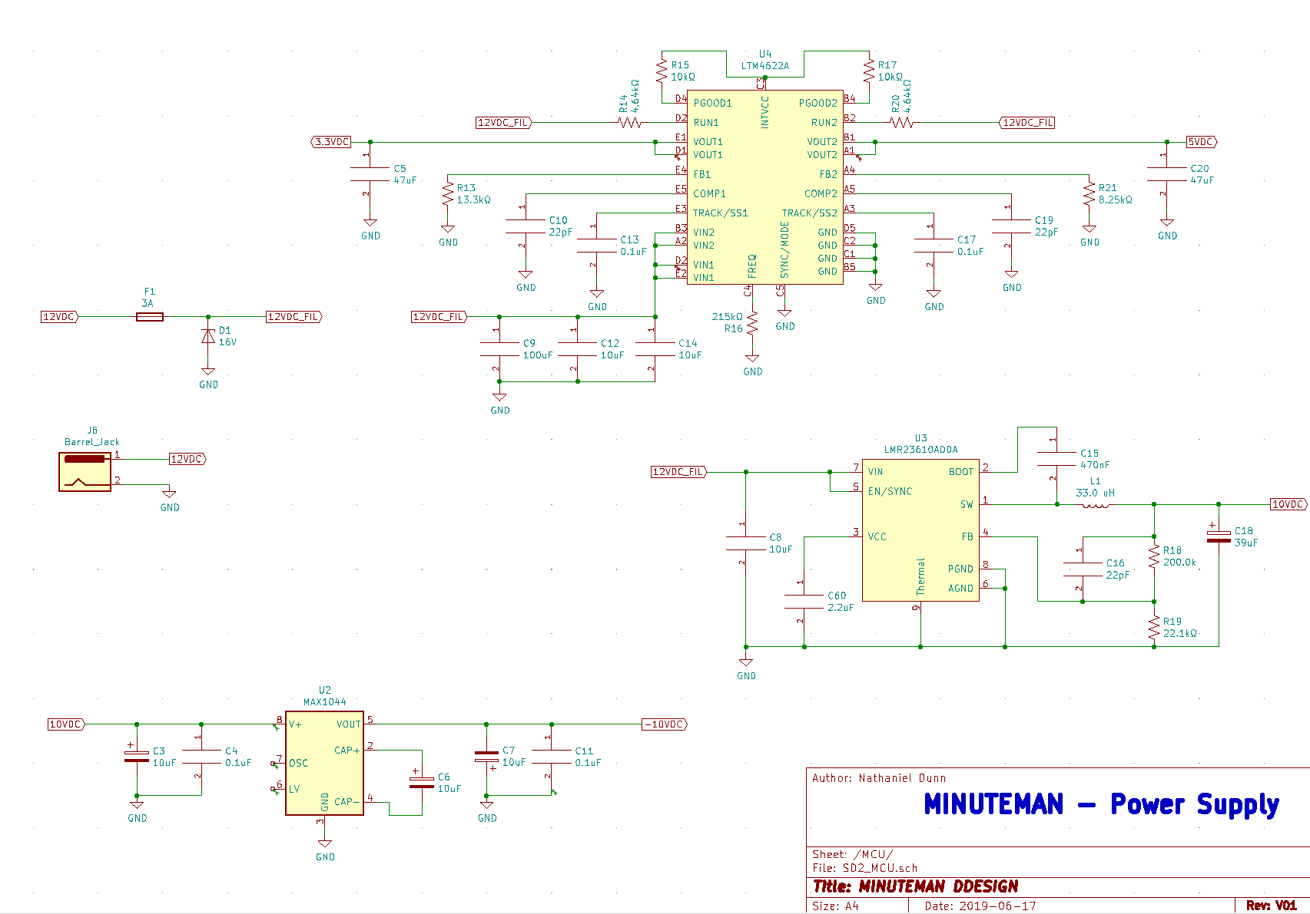
Notes:
Nathaniel

Slide 31
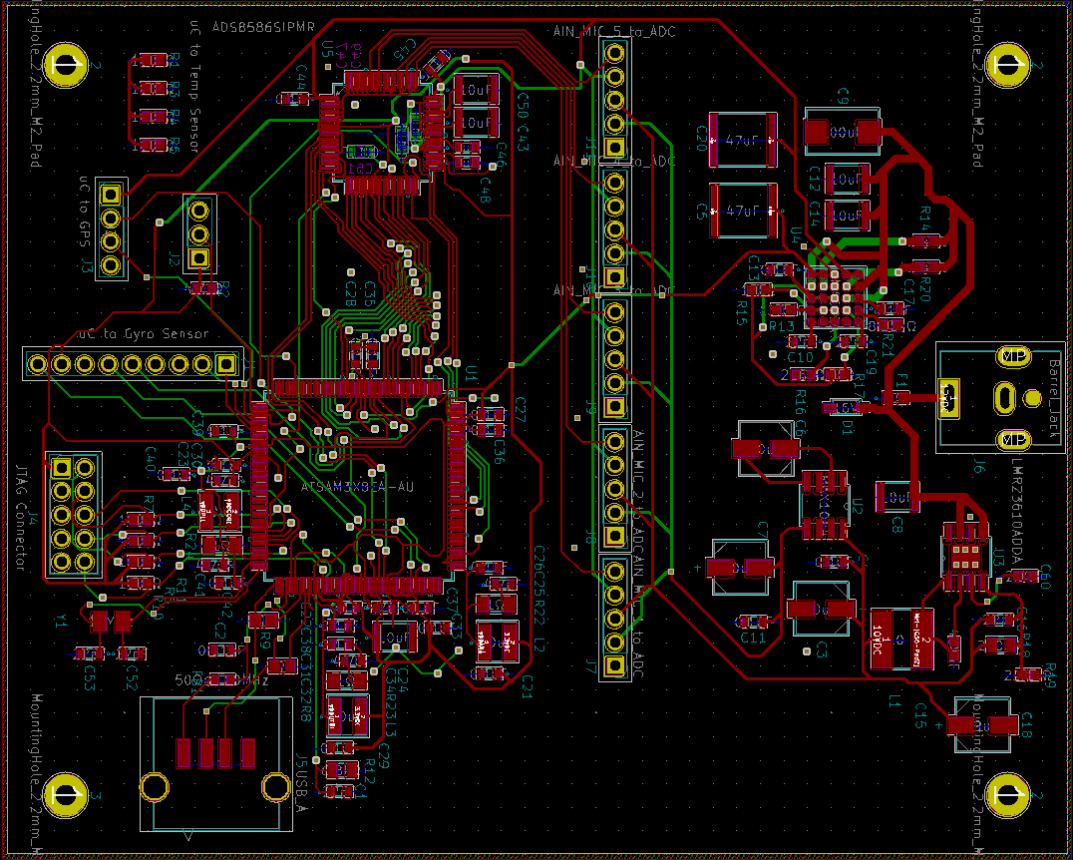
Notes:
Nathaniel

Slide 32
SOFTWARE
Notes:
Daniel, Nathan, and Eric

Slide 33
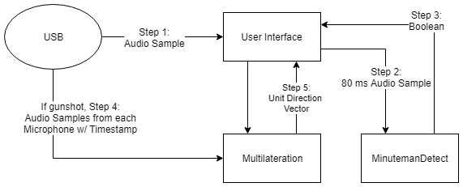
Software
Notes:
Adam

Slide 34
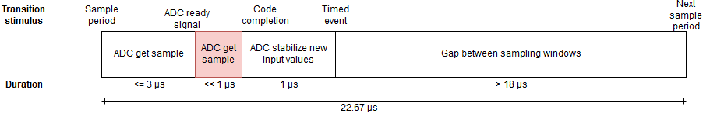
MCU Data Capture - Overview
Primary demand is to manage ADC timing restrictions, which are beyond the capabilities of on-chip peripheral and memory managers
Fundamental period of 22.67 μs per our sample frequency
The only critical section is the sampling period, as all 6 channels must be captured in tight sequence
Notes:
Adam and Daniel

Slide 35
MCU Data Capture - Overview
Dead time is filled with one of the following when timers specify:
USART DMA request to read from the compass
USART DMA request to read from the GPS
USB packet preparation and transport to USB-allocated buffers
Notes:
Adam and Daniel

Slide 36
MCU Data Capture - Overview
USB packet transmissions require active software management of the driver, leading to a few complications
Packet reads require nothing beyond message interpretation
Host-bound packets require header construction and transmission control
The USB protocol cannot be interrupted by the pictured critical section
Notes:
Adam and Daniel

Slide 37
Gunshot Detection
Detection is handled by a pre-trained convolutional neural network.
Our UI passes information gathered from the USB to a Python script using a named pipe.
The Python script passes the data through a wavelet transform function before classifying it.
The script passes a boolean value back to the UI through the pipe.
Notes:
Daniel: On the host computer, gunshots are detected using binary classification. This is handled by passing the data to a python script using a named pipe hosted by our UI. The data is transformed and then classified by the network. Then the script passes a boolean back confirming if it is a gunshot or not.

Slide 38
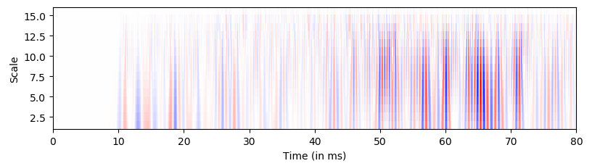
Scalogram of a Muzzle Blast
White are near zero values, Blue are large negative values, and Red are large positive values
Calculated using PyWavelets library, providing a 2D array of waveform magnitude values.
Wavelet transform presents the data in “windows” of frequency and time, with resolution of both adjusting based on scale.
A low scale represents data with high frequencies and a significant time resolution, with higher values presenting low frequency information over a small time resolution.
Notes:
Daniel: This is a scalogram of a gunshot .wav file, after it was converted by the wavelet transform function. The reason we chose a wavelet transformation instead of a fourier transformation is because a wavelet transform offers a better analysis by providing more dynamic frequency and time information.

Slide 39
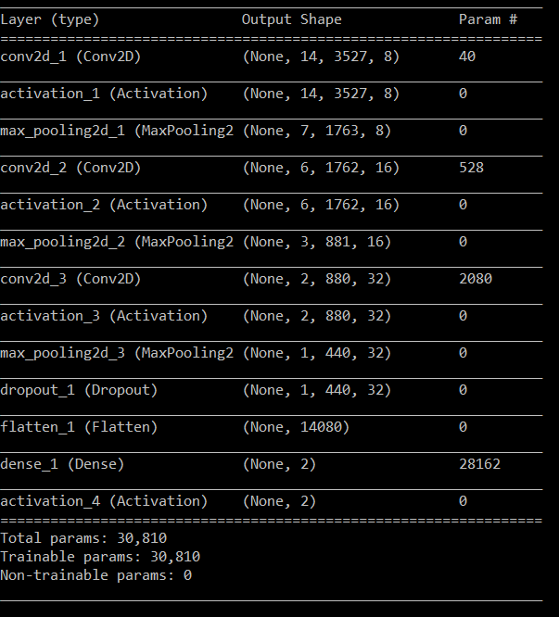
The Convolutional Neural Network
Training is handled in Python, utilizing an original training and testing dataset.
Google Collaboratory is used to speed up training and testing time.
Training, Testing, and Implementation is handled by the Keras library, using TensorFlow as the backend.
Notes:
Daniel: We chose to use a convolutional neural network for it’s high accuracy. A separate script was used for training the CNN, which is then loaded imported into the main script using a .h5 file. We chose Python because it has better support for neural networks and our transformation function. Keras was used for its ease of use and simplicity.

Slide 40
Network Architecture
3 2D Convolutional Layers with a Tanh activation function and 2D Max Pooling.
A dropout layer set to a rate of 25%.
A flatten layer to flatten the data into a format readable for the fully-connected layer.
A fully-connected output layer with a sigmoid activation function.
Binary Cross Entropy Loss Function.
Adam Optimization Function.
Notes:
Daniel: The architecture for our network is rather simple. We have 3 2D convolutional layers with dropout and a fully-connected output layer. Our loss function is a binary cross entropy with an Adam optimization function.

Slide 41
Final Test Accuracy
The gunshot dataset was gathered using a secondary microphone. In final testing the network achieved an accuracy of 59/60 (99.167% accuracy based on loss).
Notes:
Daniel: With everything trained, we managed to achieve a high detection accuracy, while also being able to predict a new sample within 20ms.

Slide 42
User Interface
A software program that a user can use in a computer to run the Project Minuteman system.
The main programming language used in making the interface will be C# Windows Forms, using Microsoft Visual Studio.
Main source of presentation for relaying information needed by the user like:
A timestamp of when the gunshot was captured by the system
An alert if a gunshot is detected or not
General direction of where the audio was captured relative to the Minuteman system using the Google Maps Satellite View
Notes:
Nathan

Slide 43
User Interface Traits
In future development, users can install the software from the group’s website
Have the ability to create an account and log in/log off with ease so each user can have their own workspace
Convenience to be able to run in the background to acquire the necessary information
Notes:
Nathan

Slide 44
User Interface Process
When Record button is pressed, data is sent from the USB to the Neural Network to initialize and for training/testing.
Once the network determines if a gunshot is detected, it sends a boolean back.
The data is then sent into the algorithms to be able to acquire the direction vector that is converted to latitude and longitude for a general direction.
The timestamps, alerts, and general direction line are all shown in the main interface. The microphone system is shown by a marker with an arrow indicating general direction of the audio.
The whole process is halted when the Stop button is pressed.

Slide 45
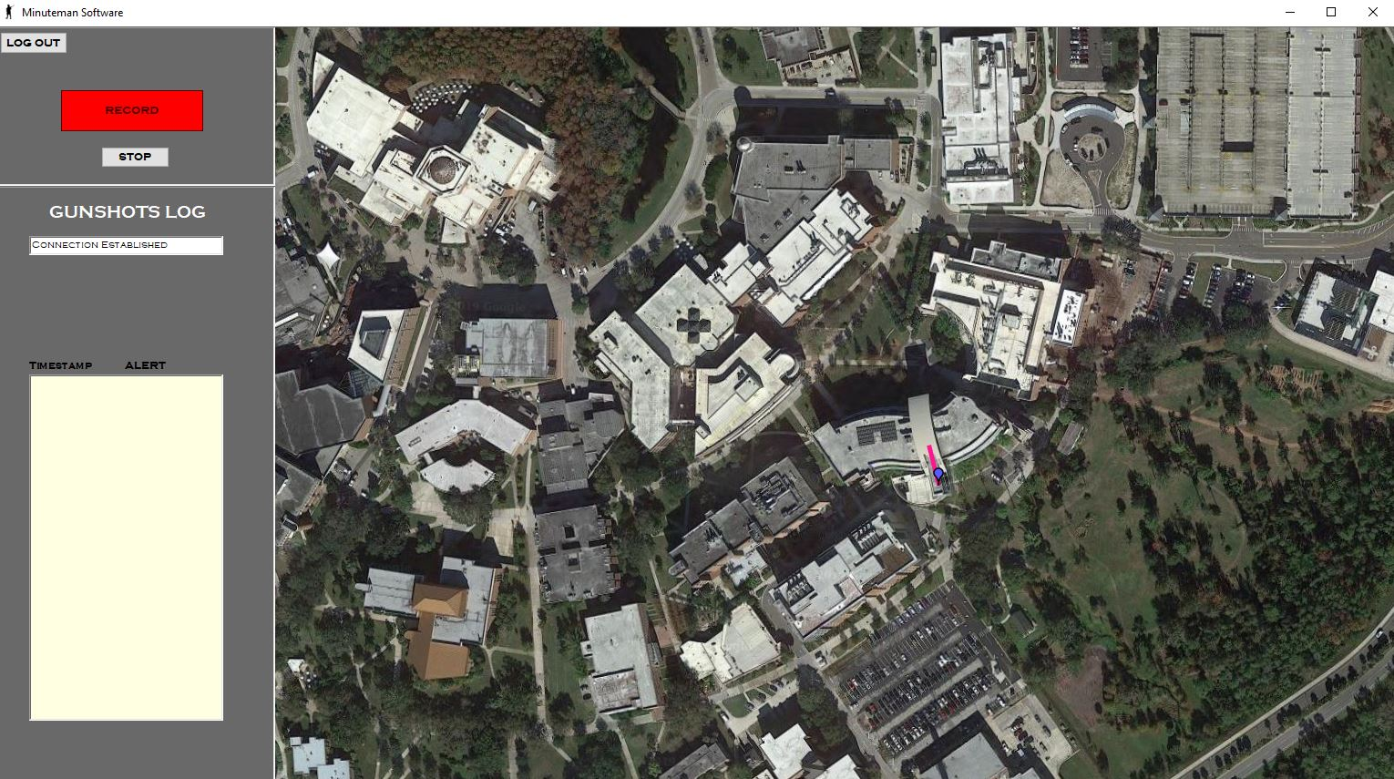
Main Interface View

Slide 46
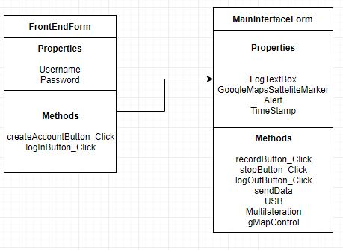
UML
Notes:
Nathan

Slide 47
Work Distribution
 | PCB Design | Power | Embedded Prog. | Sensor Config | Data Processing | GUI
Nathan Cunanan, CpE |  |  |  |  | S | P
Nathaniel Dunn, EE | P | P |  | S
Daniel Vicenti, CpE |  |  |  |  | P | S
Eric Watson, CpE+EE |  |  | S | P | S
Adam Bush, CpE | S |  | P | S
Primary, Secondary
Notes:
Nathan

Slide 48
Project Budget and Financing
Material/Part | Quantity | Price ($) | Total ($) | Material/Part | Quantity | Price ($) | Total ($)
Arduino Due | 1 | 48.00 | 48.00 | Gyroscope | 1 | 34.34 | 34.34
MCU | 2 | 11.54 | 23.08 | GPS Module | 1 | 15.99 | 15.99
Power Adapter | 2 | 2.99 | 2.99 | Temp Probe | 1 | 8.20 | 8.20
V Regulator | 2 | 17.31 | 34.62 | Amplifier | 25 | 0.15 | 4.20
Inverter | 4 | 1.43 | 2.86 | PCB Costs | 20 | 5.00 | 100.00
Microphone | 12 | 2.12 | 25.44 | Misc. | N/A | 50.00 | 50.00
Total | $355.57
Notes:
Adam And nathan
MAX is a inverter
CMC microphone
BNO gyroscope
Maxim temp probe
TL amplifier

Slide 49
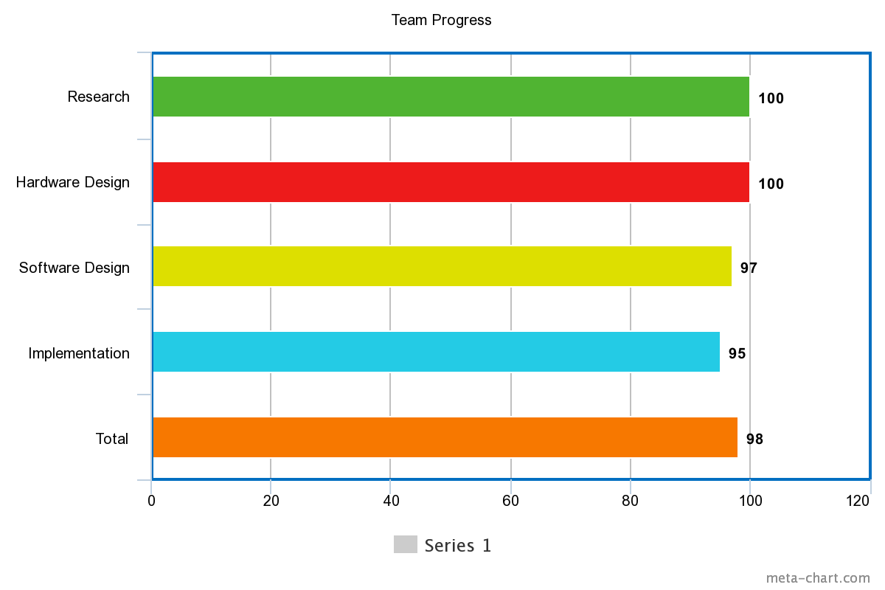
Team Progress
Notes:
Nathan

Slide 50
Difficulties
USB to PC connection fails to pass basic initialization stages with errors both in the transmission rate, measured on oscilloscope and as reported by Windows, and the packet transmitted is an uninitialized identifier from the device to the host (PC), with 0s in place of the vendor and product ID
Notes:
Adam

Slide 51
References
[1] Gunshot acoustics primer
http://www.montana.edu/rmaher/publications/maher_aac_0406.pdf
[2] Gunshot sound signatures
http://www.montana.edu/rmaher/publications/maher_aesconf_0608_1-8.pdf

Slide 52
Questions?

